Slide 1
Anomaly detection and TinyML
11.3.2025

Slide 2
Contact persons and information
Host / Tutor: PhD, Postdoctoral researcher Anna-Maria Raita-Hakola anhakola@jyu.fi +358 405492120
Research group leader Ilkka Pölönen ilkka.polonen@jyu.fi
Place to work: Spectral Imaging Laboratory Faculty of Information Technology, University of Jyväskylä
Work address: Mattilanniemi 2, 40100 Jyväskylä Finland
International services:
Niina Ormshaw, our Faculty's International Affairs Coordinator (Erasmus, studies at JYU)
Sari Smahl is from our International Staff Services (ISS). ISS advises you before you arrive on matters such as entry and accommodation (housing)

Slide 3
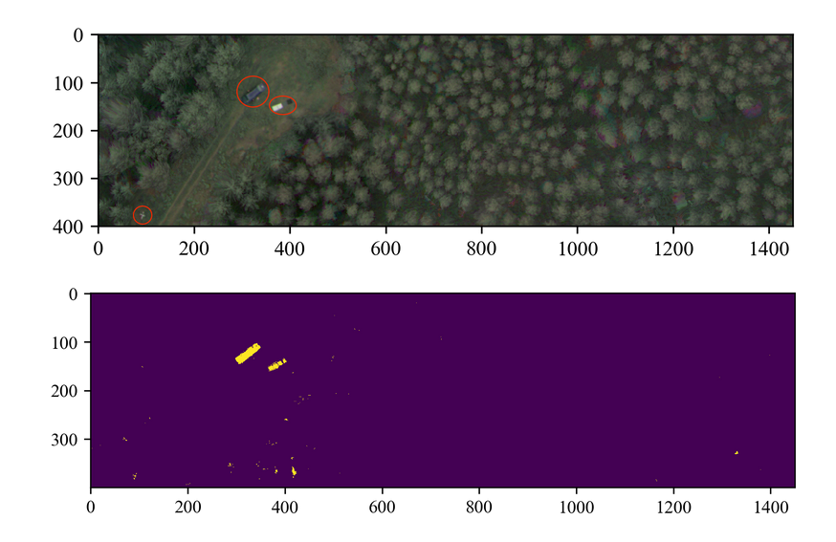
What is anomaly detection?
The ultimate goal is to teach model to understand what is normal behaviour and what is abnormal (anomaloys).
In our current forestry research, abnormal is a stress signal, that can be detected from a tree that has bark beetle infection.
For that, we are using highly dimensional spectral data that is gathered using UAV’s or other remote sensing platforms
Raita-Hakola, A.-M., & Pölönen, I. (2021). Piecewise anomaly detection using minimal learning machine for hyperspectral images. ISPRS Annals of the Photogrammetry, Remote Sensing and Spatial Information Sciences, V-3-2021. https://doi.org/10.5194/isprs-annals-V-3-2021-89-2021
Pölönen, I., Riihiaho, K., Hakola, A.-M., and Annala, L.: MINIMAL LEARNING MACHINE IN ANOMALY DETECTION FROM HYPERSPECTRAL IMAGES, Int. Arch. Photogramm. Remote Sens. Spatial Inf. Sci., XLIII-B3-2020, 467–472, https://doi.org/10.5194/isprs-archives-XLIII-B3-2020-467-2020, 2020.

Slide 4
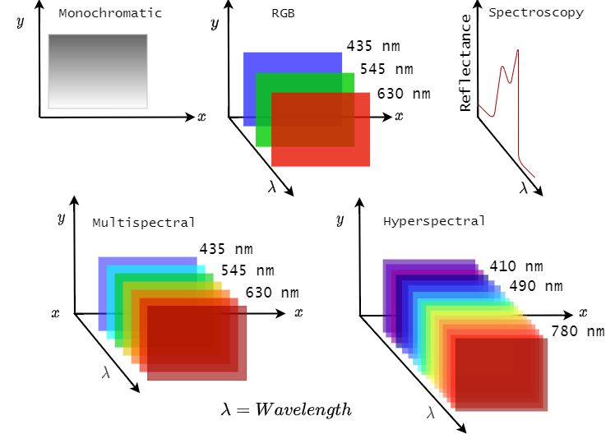
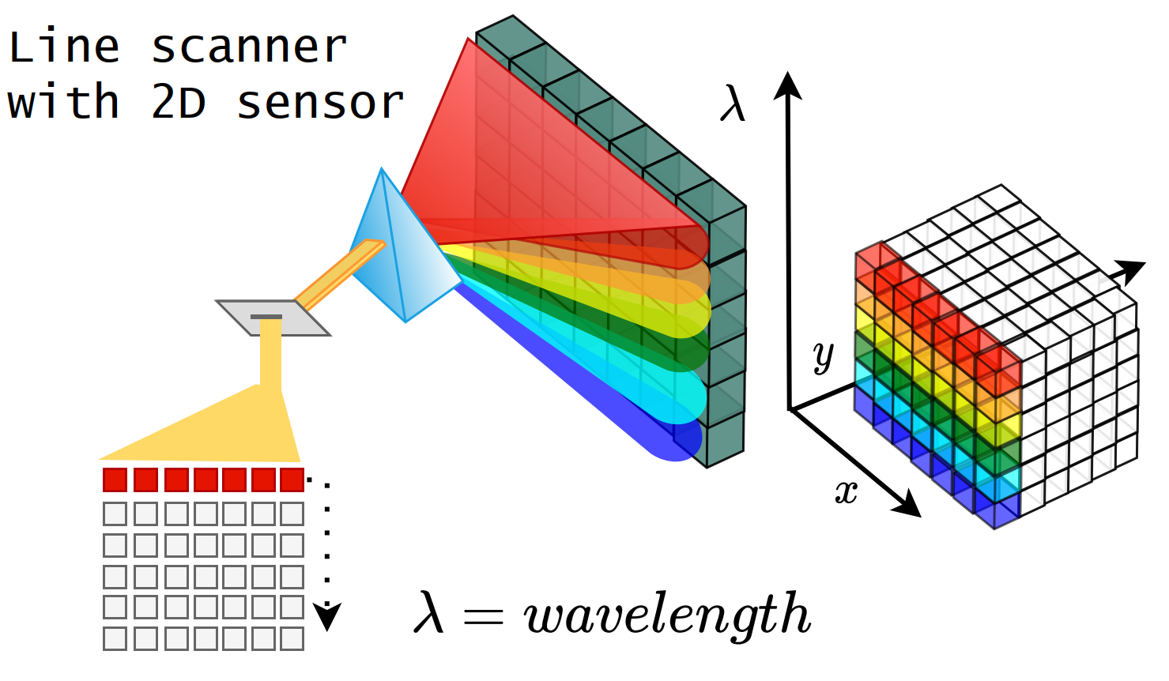
What is hyperspectral data?

Slide 5
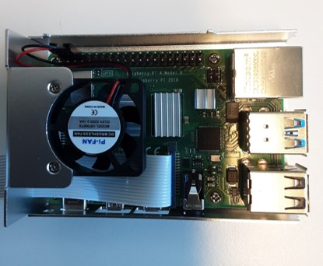
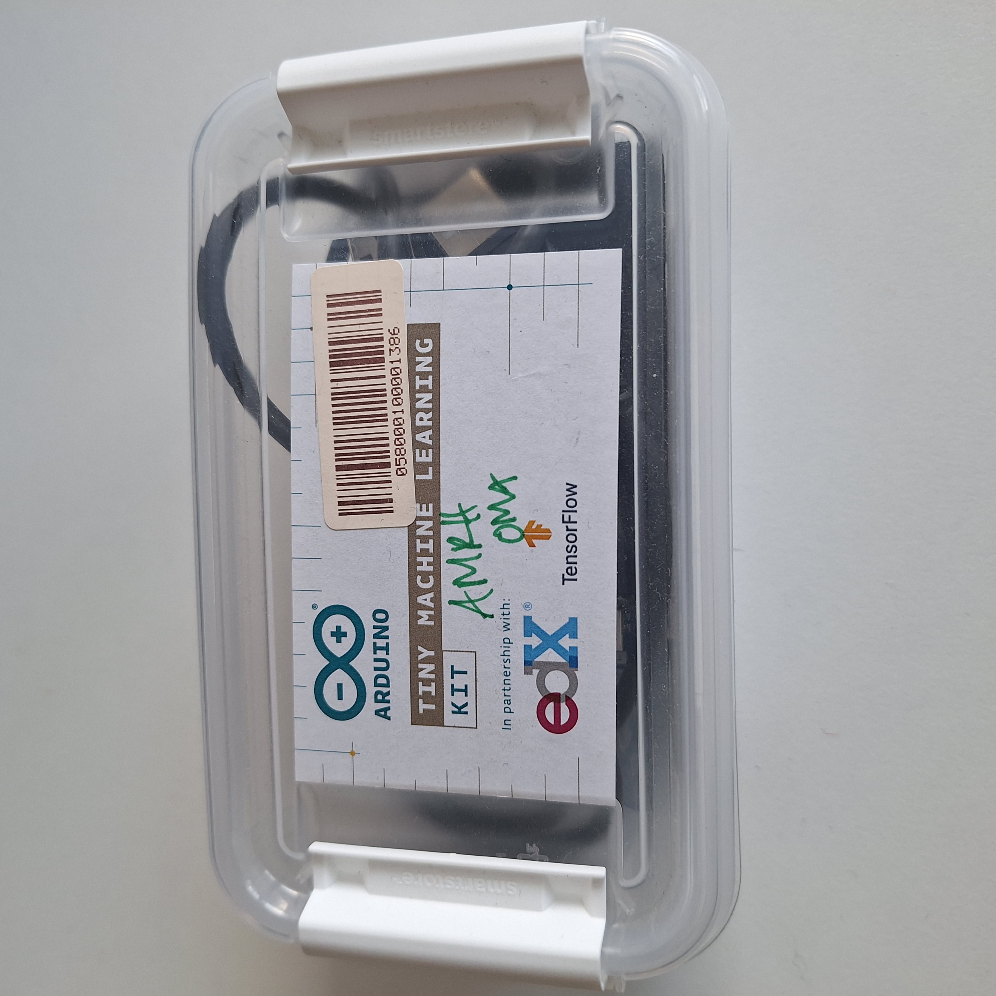
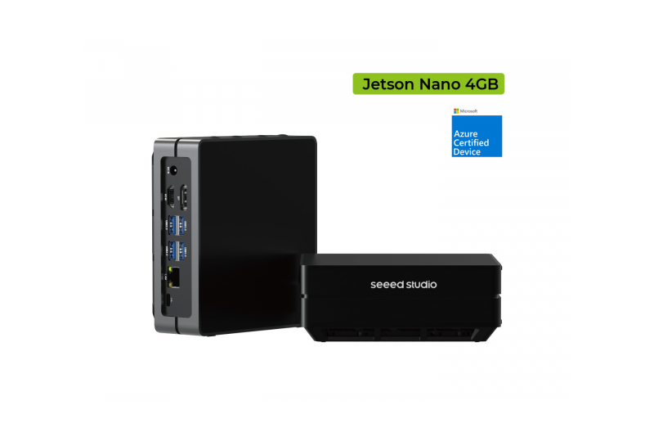
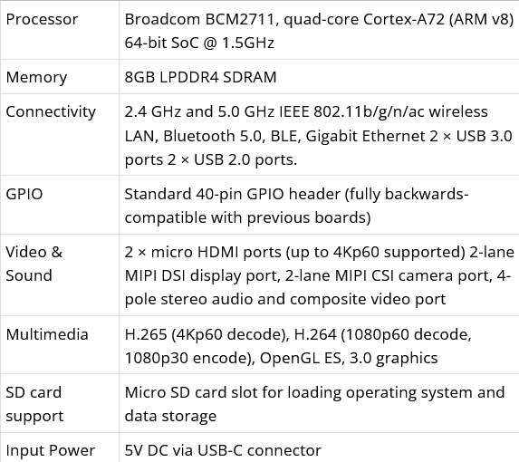
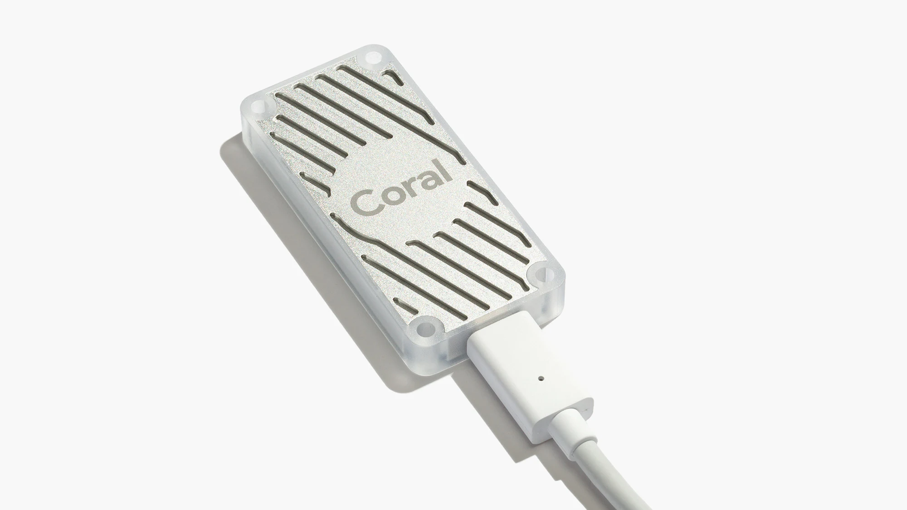
Arduino Tiny ML, Raspberry Pi, Jetson Nano
Possible devices to work with:
Arduino Tiny ML kit
Raspberry Pi 4 8GB or 5 8GB
Jetson Nano 4GB
Coral accelerator

Slide 6
Possible work could:
Use HS data (extra challenging due to high dimensions of data)
Use one or few platforms (Arduino etc.)
Select one or few anomaly detection method(s)
Design how to implement those into selected platform(s)
Implementation, tests and documentation
This could be a short reseatch letter we can publish together afterwards
Limits: We don’t have to do actual IoT system, just try to optimise and implement models into platforms and see how they perform.

Slide 7
Studies in JYU and living in Jyväskylä
If you wish to have student status, we need to assign you into some courses or plan the visit as a research project which gives you ECTS
Relatively cold climate, typical weather in sring may be cold with snow or warm (around 20 to 24 degrees). Summer is typically around 20 degrees and rainy… or extreme: +30 and sunny.
Easy town to move around. Short distances and plenty of nature around us. We can find ways to introduce you to other (international) students besides our research team.

Slide 8
Timing and supervising
Anna-Maria will be the host at JYU
14.5.-15.8.2025
July is challenging – holiday 7.7. – 4.8.
ML4DRONE project
Supervising:
- We offer place to work at our research group. We can supervise your work, however, we have limited time resources for hands-on teaching. So if you are willing to be proactive, and are independent learner, it would be great ☺.

Slide 9
Tiny devices and anomaly detection,some examples of what others have done
A review: https://www.sciencedirect.com/science/article/pii/S2542660524000052
UAV point-of-view:
https://dl.acm.org/doi/fullHtml/10.1145/3579375.3579383

